Slide 1

Developed By: Wilmer Suarez Email: Wilmer.Suarez@Stonybrook.edu SBU ID: 109592501

Slide 2
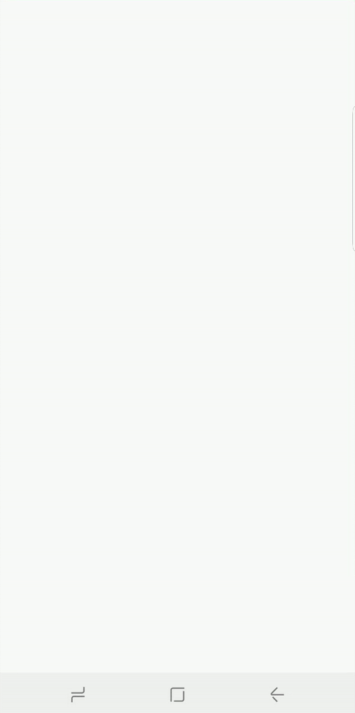
WELCOME SCREEN

Slide 3
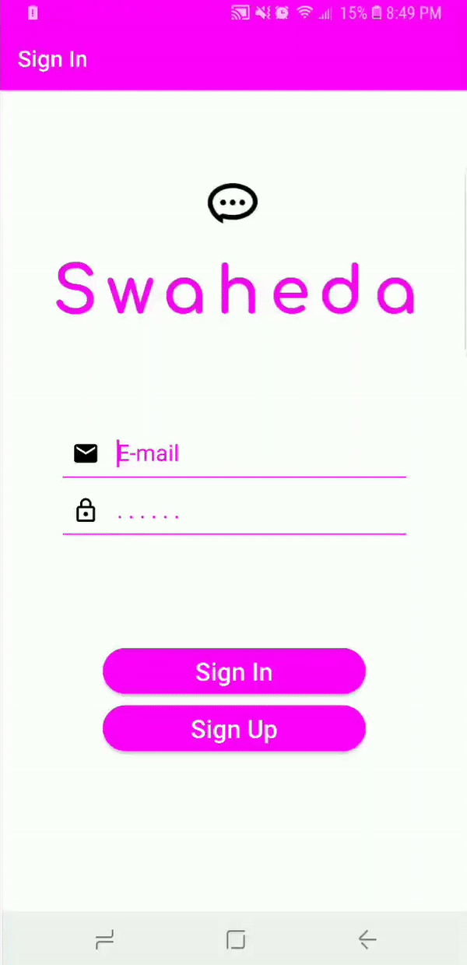
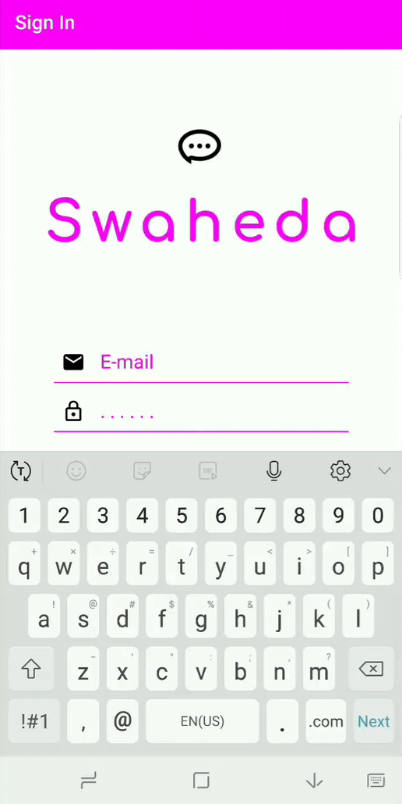
LOGIN/SIGNUP
Creating a new account:
Logging in to existing account:

Slide 4
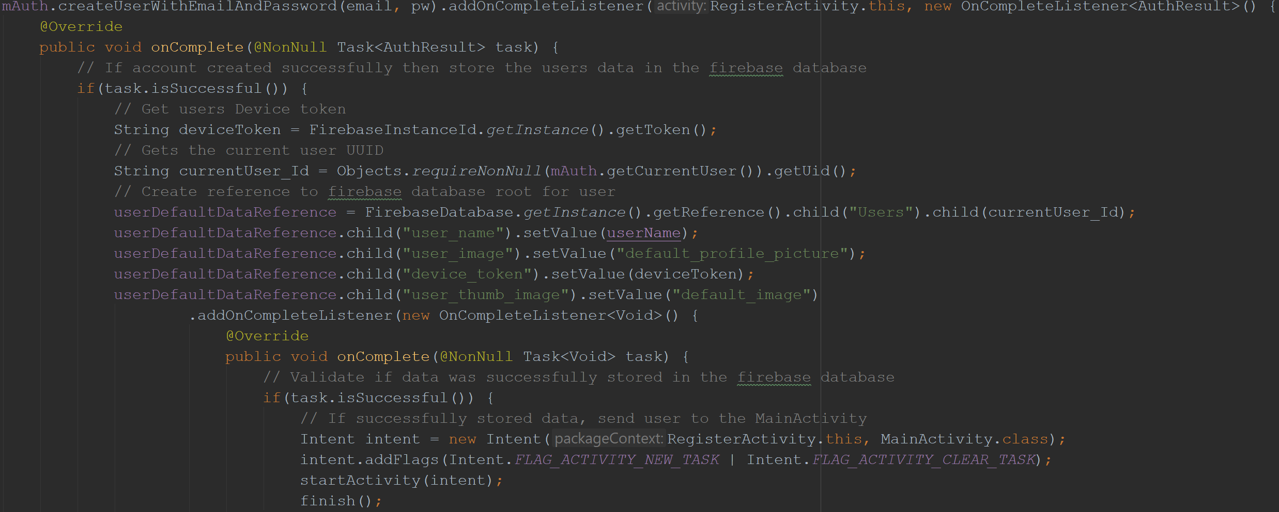
FIREBASE AUTHENTICATION
FirebaseAuth Object – Create User with E-Mail and Password

Slide 5
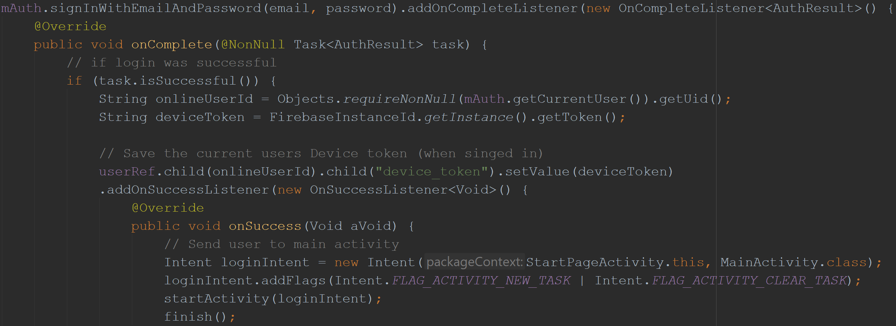
FIREBASE AUTHENTICATION
FirebaseAuth Object – Sign in with E-Mail and Password

Slide 6
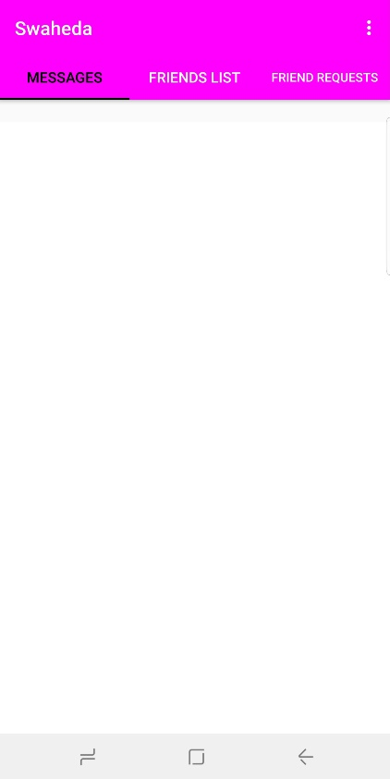
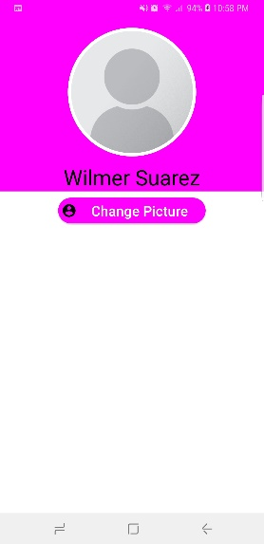
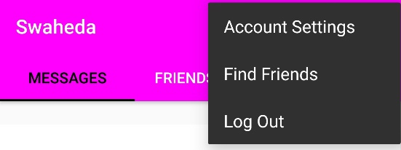
ACCOUNT SETTINGS

Slide 7
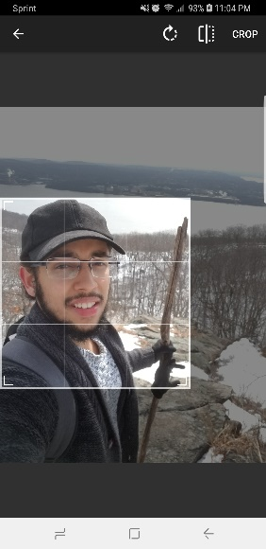
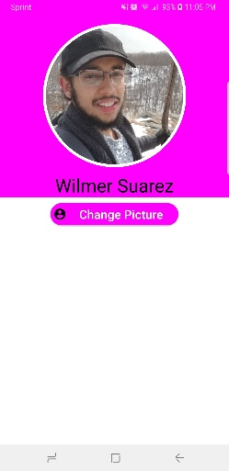
ACCOUNT SETTINGS
Changing Profile Picture

Slide 8
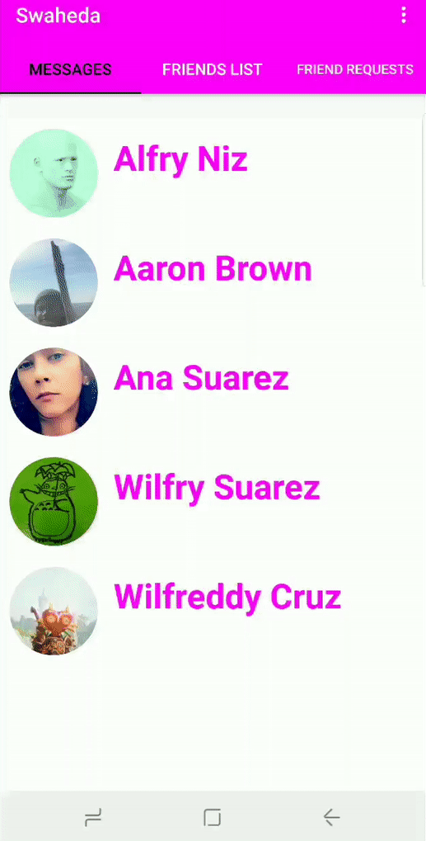
FIND FRIENDS

Slide 9
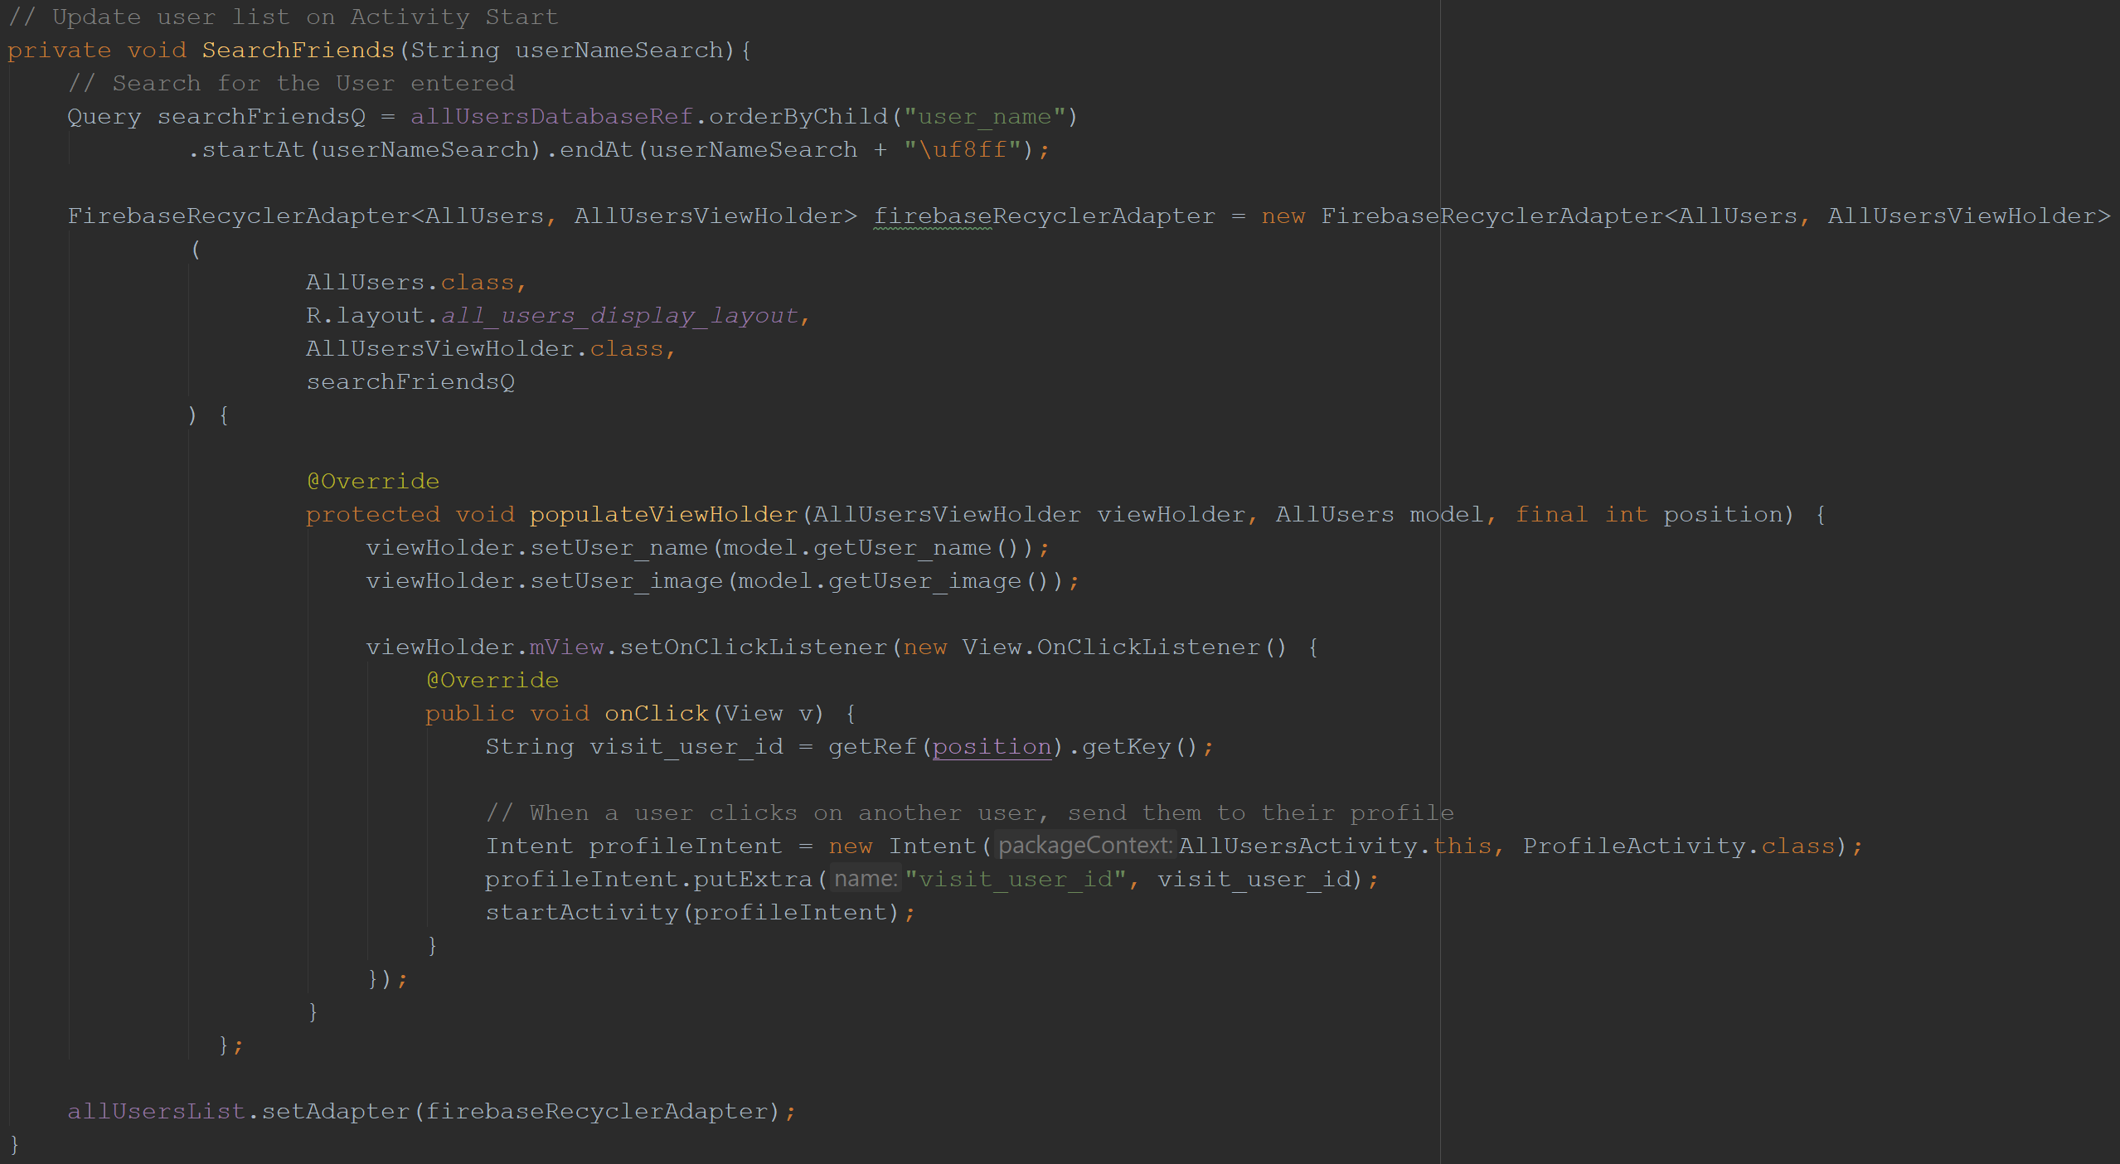
FIND FRIENDS

Slide 10
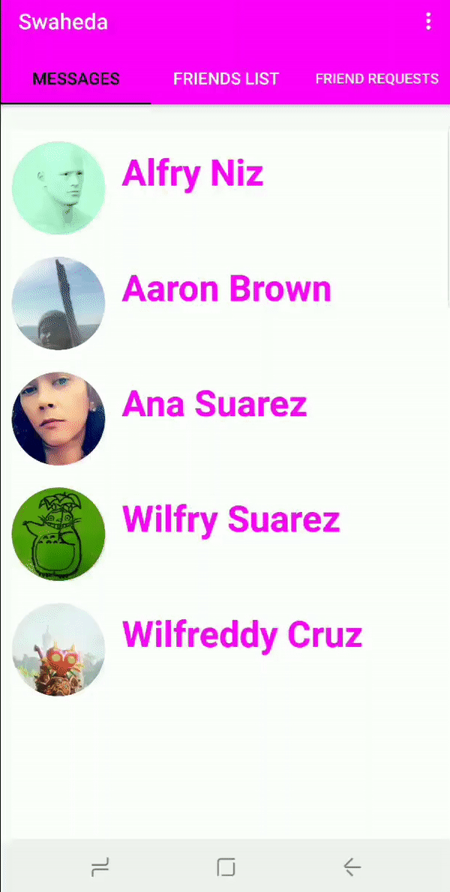
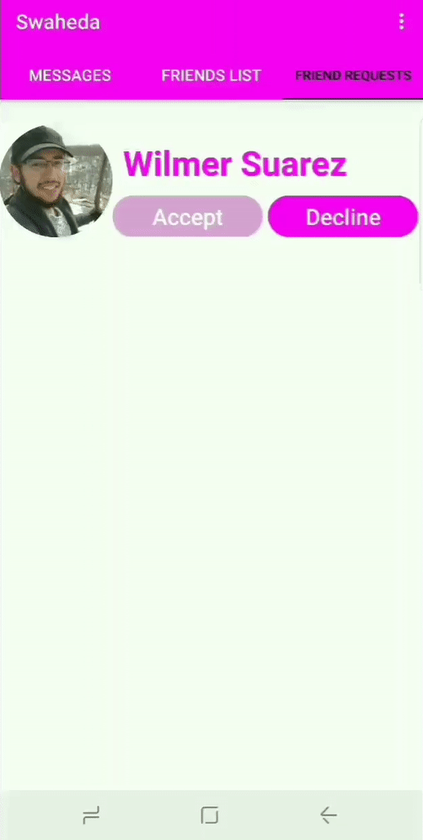
FRIEND REQUEST
Sending Friend Request
Accepting Friend Request

Slide 11
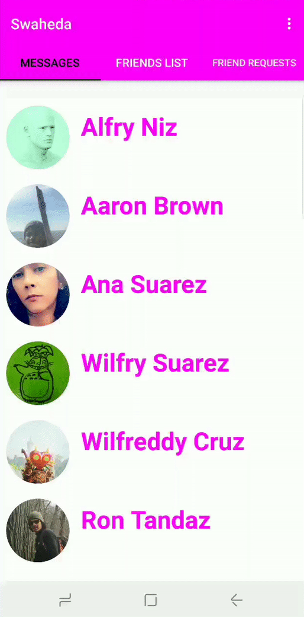
LOG OUT

Slide 12
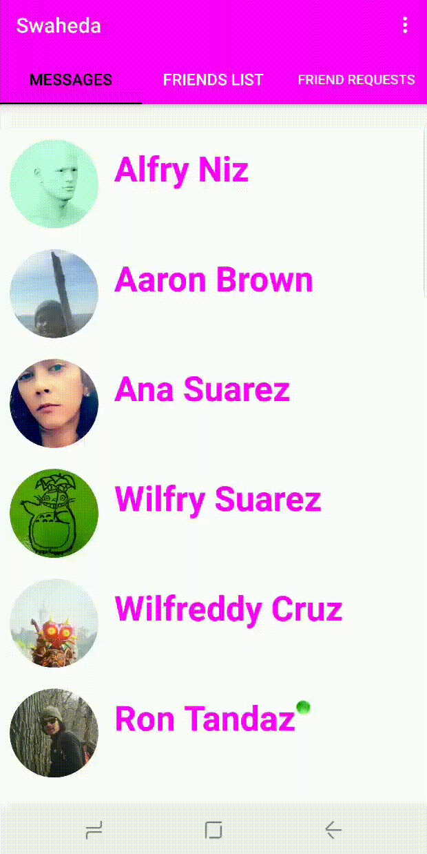
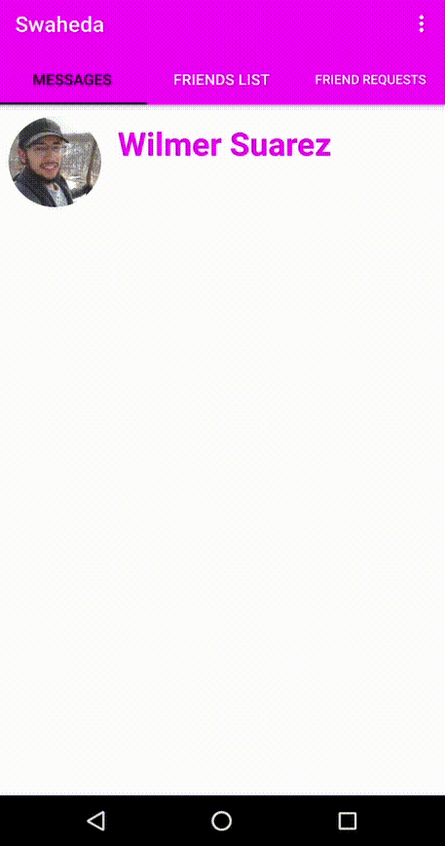
CHATTING
Current User
Current User’s Friend

Slide 13

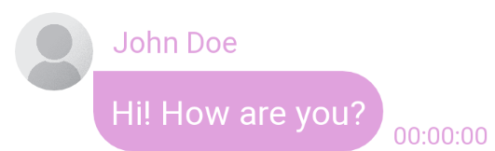
CHATTING
Implemented using a RecyclerView to hold the layout for the messages and images sent/received by the users.
Two layouts were created. One for the “sender” and one for the “receiver”
Sender Receiver
It is redundant to display the profile picture and name of the sender. Therefore, two sperate layouts were created.

Slide 14
CHATTING
Two separate View Holders were created for each layout.
They were created inside a “Message Adapter” class.

Slide 15
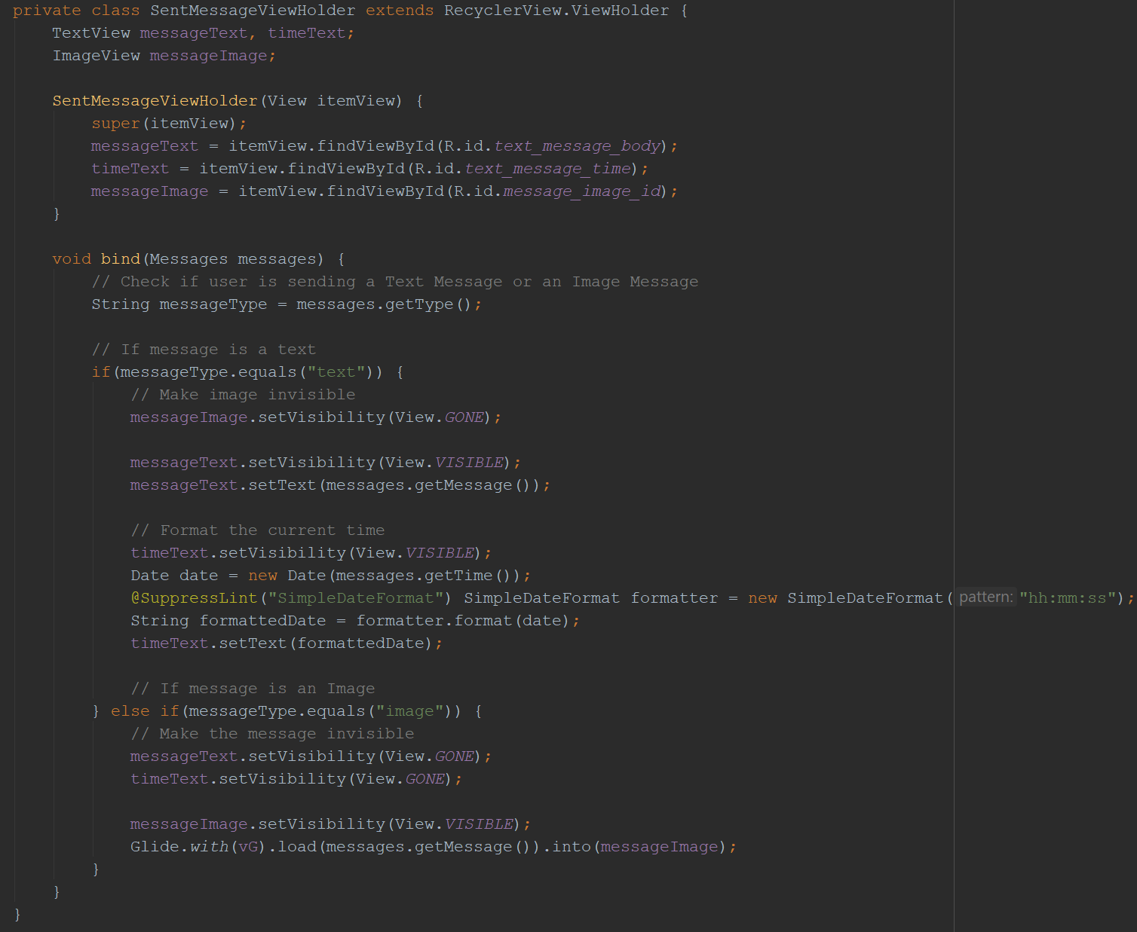
CHATTING
SENDER

Slide 16
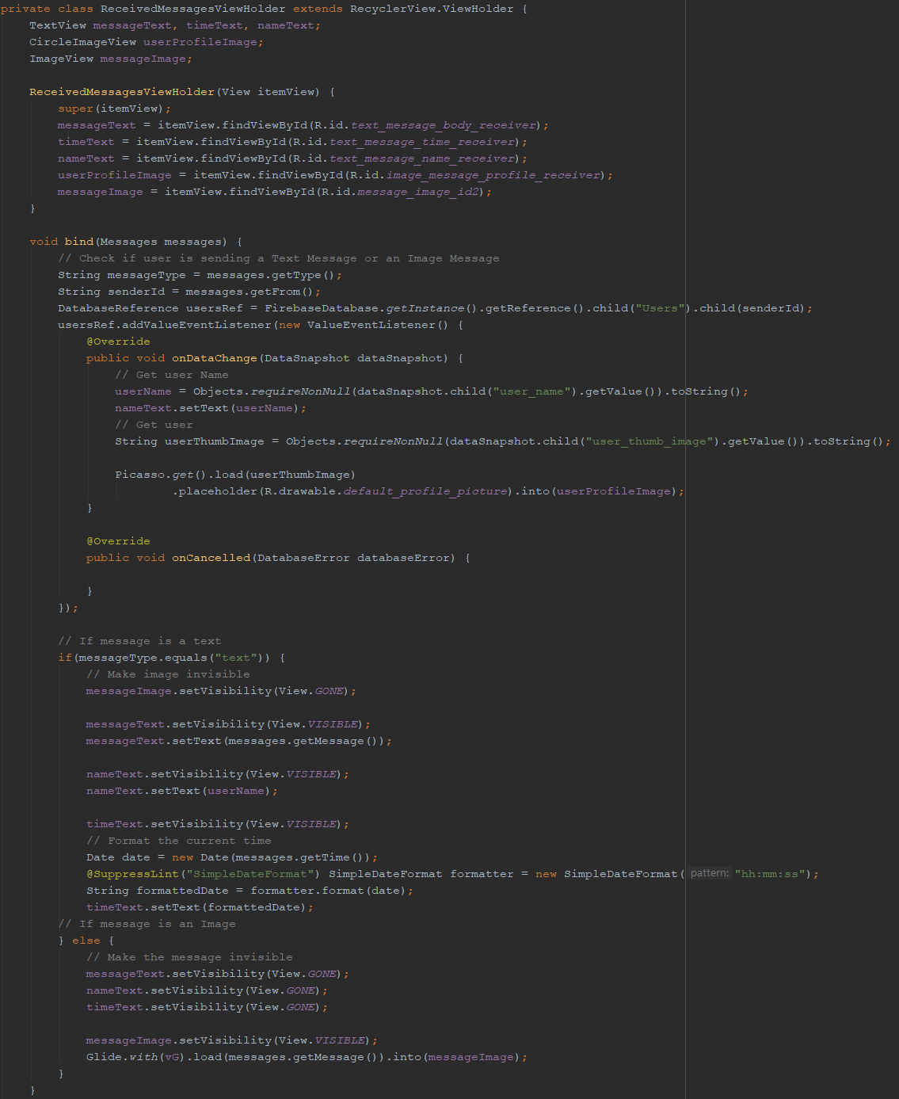
CHATTING
RECEIVER

Slide 17
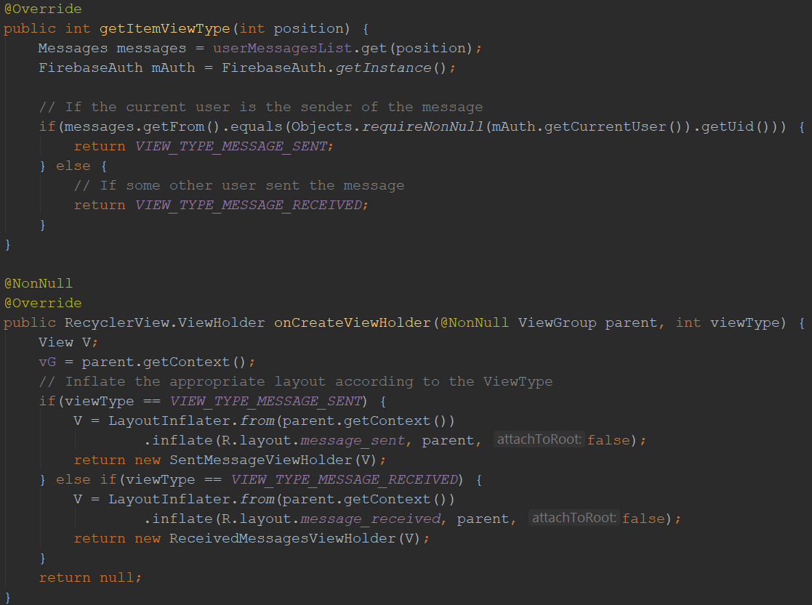
CHATTING
The Message Adapter class was used to store the list of messages, determine whether a message is a “sent” message or a “received” message, and inflate the appropriate layout within the RecyclerView.

Slide 18
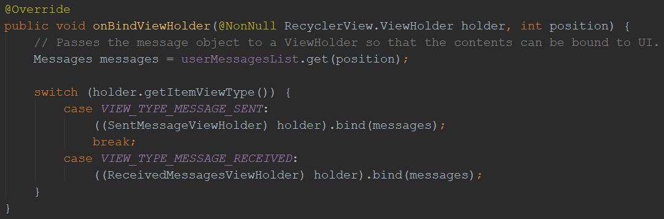
CHATTING
After determining the type of message, it is sent to the appropriate holder that binds the information contained in the message to the Views in the associated layout.

